Slide 1
Chapter – 2
Your First commit

Slide 2
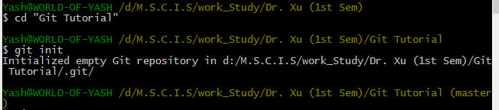
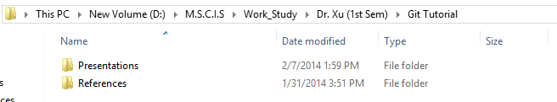
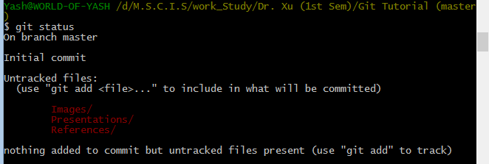
Create and initiate your repository.
Go to the project’s folder and add some file to track.
Check GIT STATUS.
1.
2.
3.

Slide 3
Using ADD and REMOVE function

Slide 4
Use GIT ADD for all.
Use GIT RM to remove a file.
Use GIT ADD for specific file.

